Slide 2
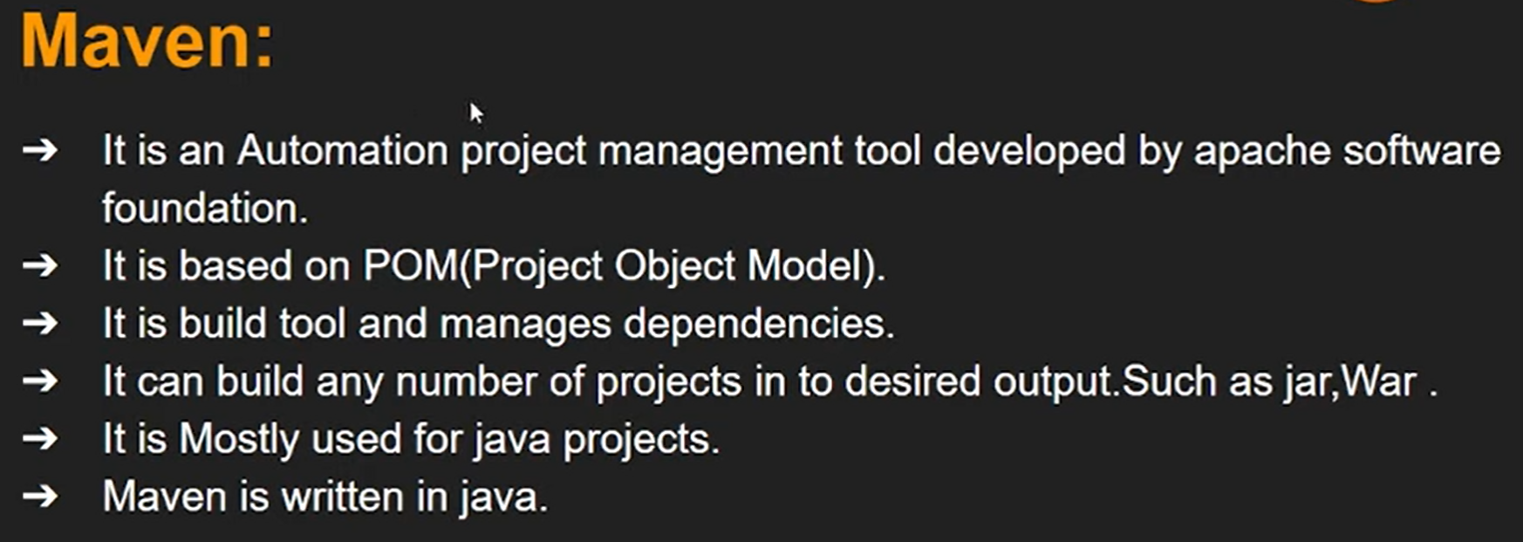

Slide 3
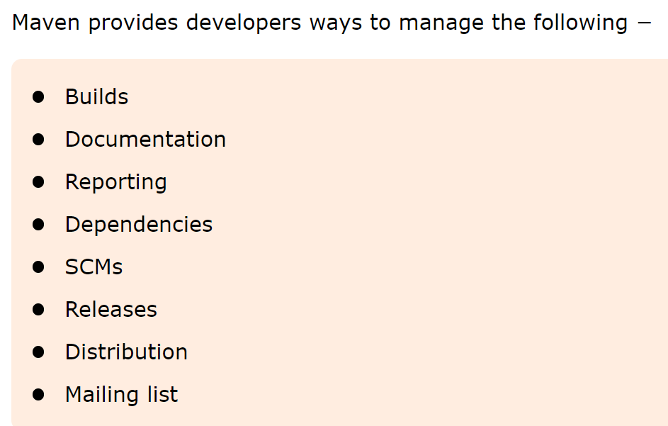

Slide 4
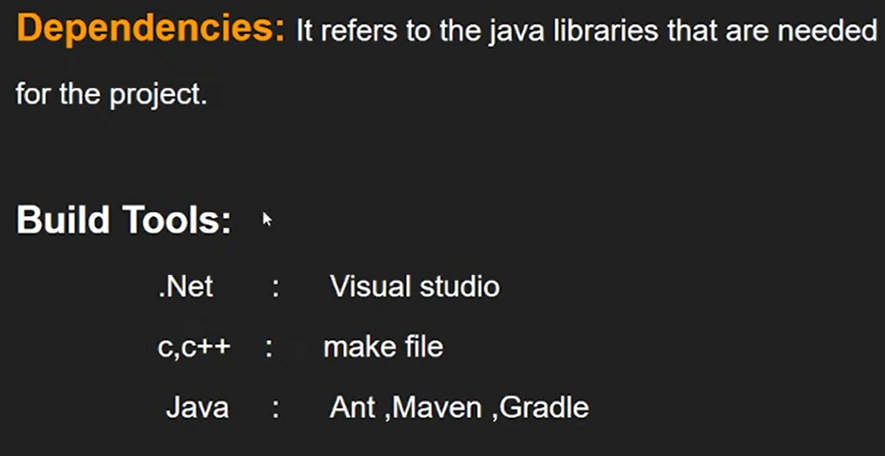

Slide 5
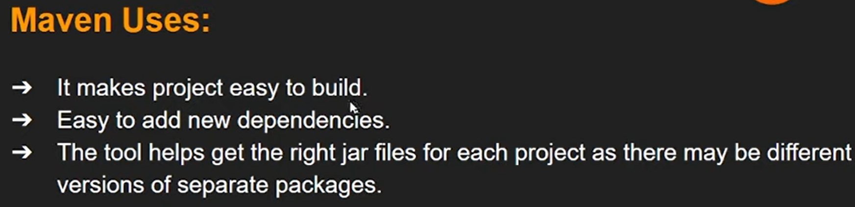

Slide 6
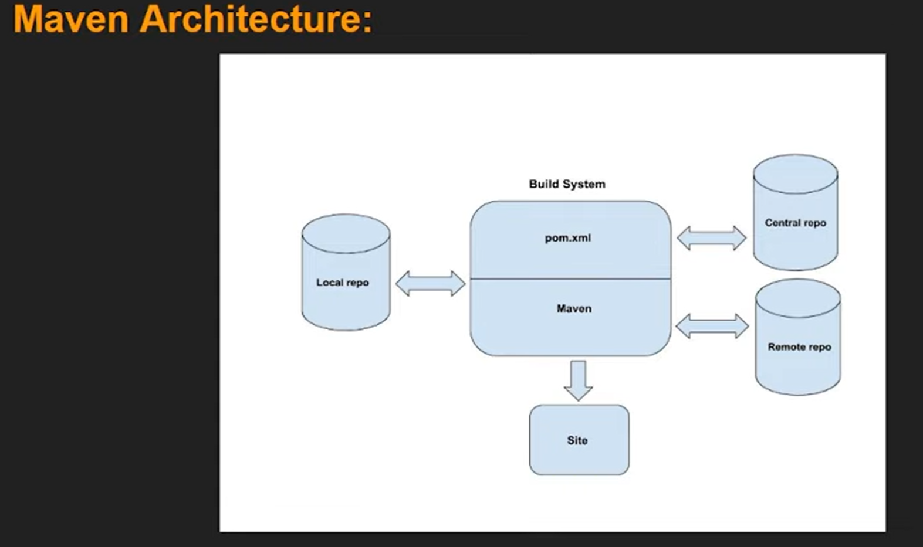

Slide 7
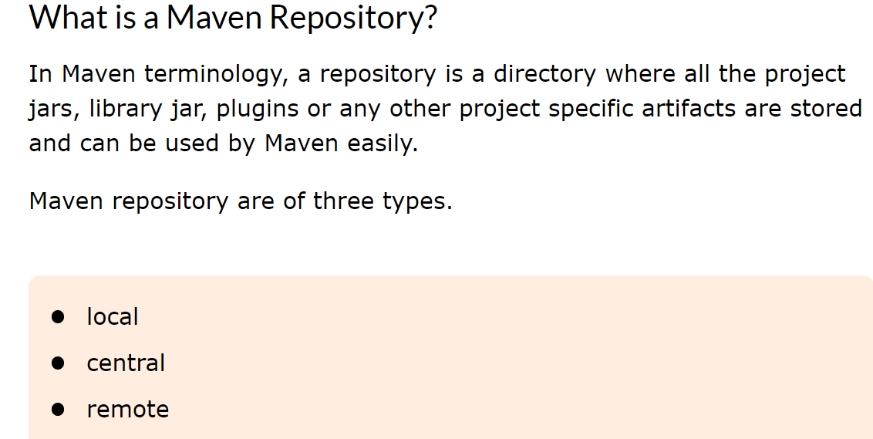

Slide 8
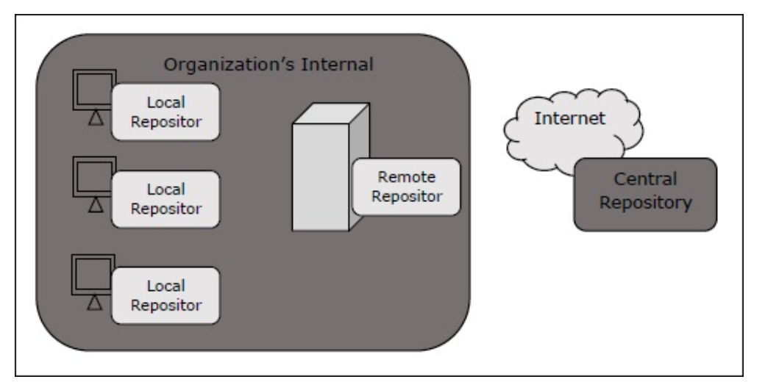

Slide 9
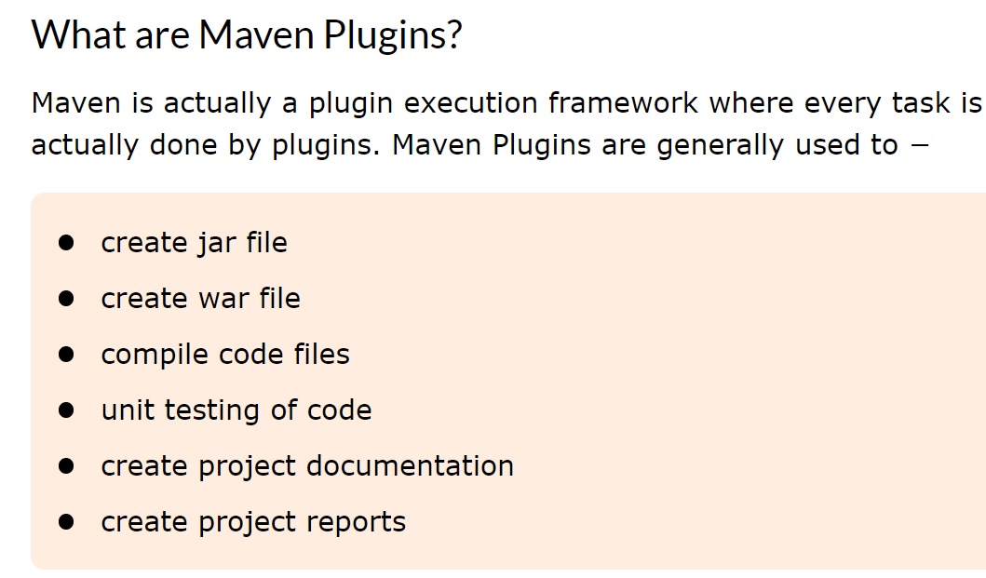

Slide 10
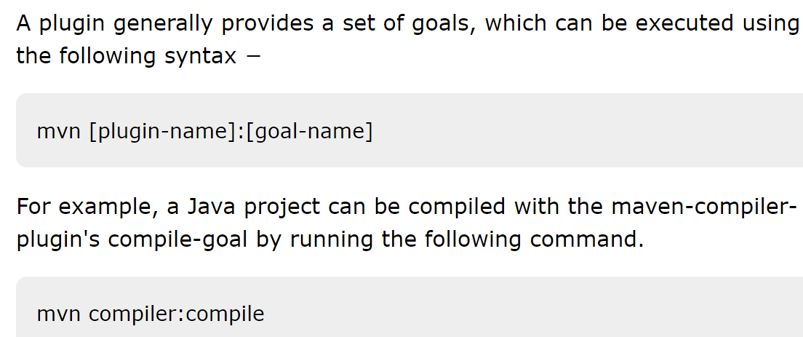

Slide 11
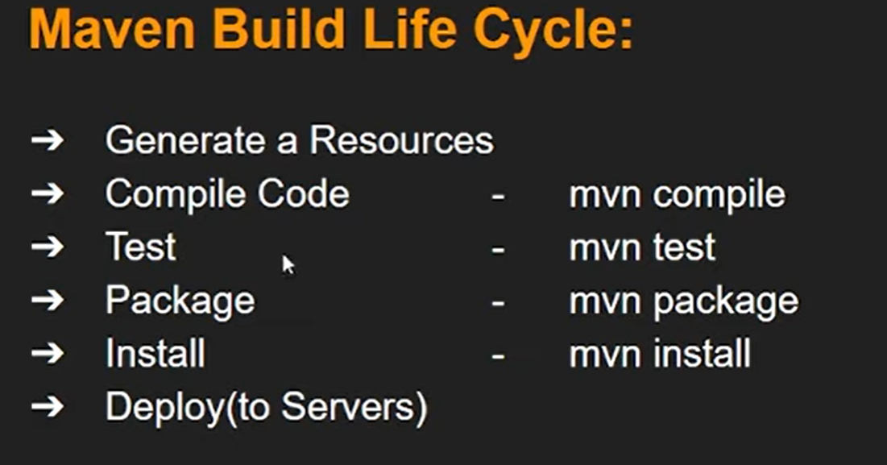

Slide 12
Maven - Creating Project
Maven uses archetype plugins to create projects. To create a simple java application, we'll use maven-archetype-quickstart plugin.
Let's open the command console, go to the C:\MVN directory and execute the following mvn command.
Make sure that C:\MVN directory is empty before running the command.
C:\MVN>mvn archetype:generate -DgroupId = com.companyname.bank -DartifactId = consumerBanking -DarchetypeArtifactId = maven-archetype-quickstart -DinteractiveMode = false

Slide 13
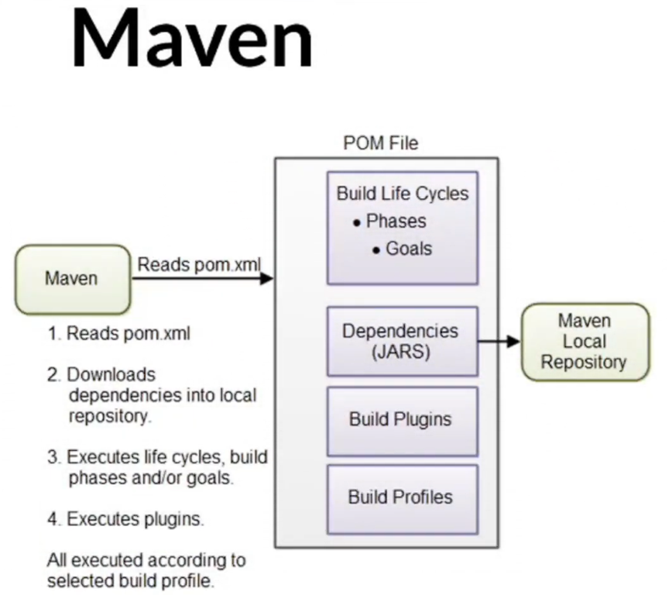

Slide 14
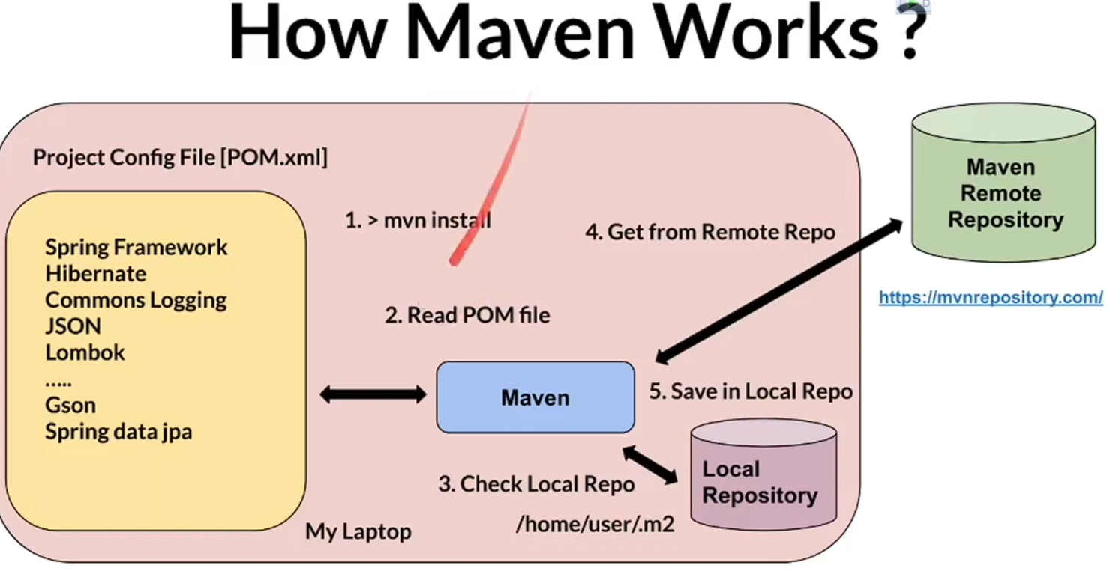

Slide 15
